Slide 1


EXITO
TN Migrant Education
Parent Training Program
Pre-K Students

Slide 2

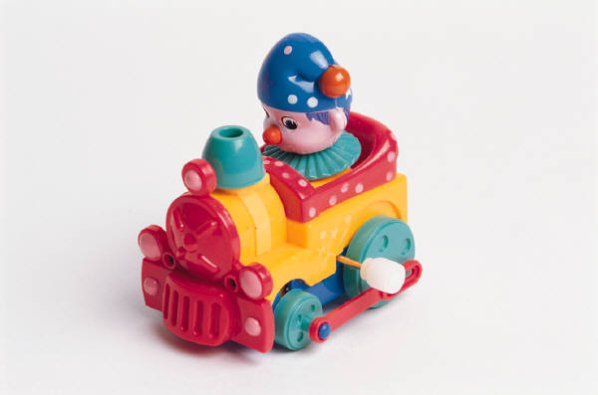

The Purpose of EXITO
From birth to adolescence, constructive play is vital to most aspects of children's intellectual, emotional, social, and physical development.
Through constructive play, children expand their intelligence - their knowledge and understanding of the world around them. Play is a testing ground for language and reasoning skills - a laboratory for learning to connect to challenges children face in school, such as literacy, math, and science concepts.

Slide 3

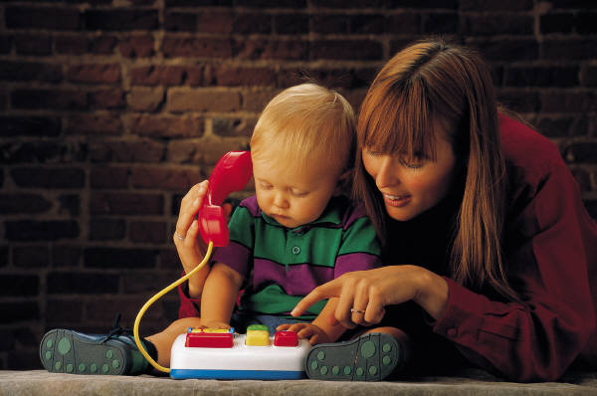
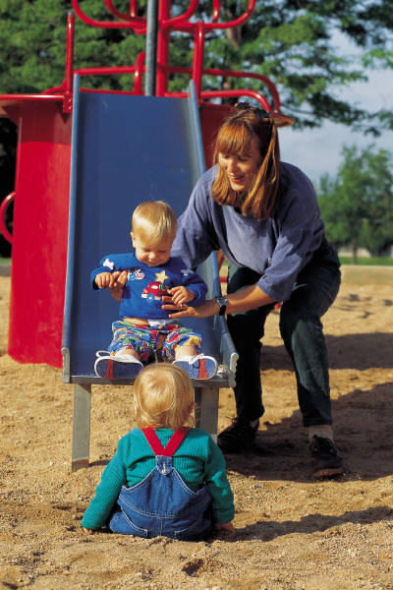

Research shows When
Parents Are Involved
Children learn more.
Perform better in school.
Exhibit healthier behavior.
Fewer behavioral problems
Higher level of sociability.
Boosts children's confidence.
Children enjoy school more.

Slide 4
Think about It!
If parents were more prepared to be their children's first teachers, the payoff would be both personal and economic. Family involvement could double the public investment in student learning, according to the U.S. Department of Education. If every parent of children aged 1 through 9 spent one hour reading or working on schoolwork with his or her child five days a week, that would be 8.7 billion hours. That number of hours, if spent by teachers in our children's schools, would cost American taxpayers at least $230 billion—about the same as what we pay yearly for K-12 public education in our country.

Slide 5
Design Of EXITO
Program Structure
Program is conducted with parents and tutor
Designed to work with the parent who then works with the child
Visits scheduled once every two weeks
Instruction with parents is in students 1st language
Visits are 1.25 hours in length
Weeks when visits are not help a tutor contacts parent to check on progress

Slide 6
Five EXITO Areas of Focus-
2 visits per subject
Colors
Body Parts
Shapes
Numbers
ABC’s

Slide 7

Getting Started- 1st Visit
First visit- tutor meets with parents to explain the program.
Tutor works to gain a relationship of trust with the parents.
If parent are interested tutor sets up a time to return to conduct the evaluation.
Before leaving tutor explains the purpose of the evaluation process to parents.

Slide 8

2nd Visit- Evaluation
Tutor explains the 5 subject evaluation to parent and explains activities that will be conducted
Parent as much as possible leads the evaluation by starting to play simple games with the child that the tutor explains.
Childs understanding of the subject areas is evaluated.
Depending on understanding the number of visits is explained to parent.
Parent Leads as
Much as Possible

Slide 9

Evaluation
Simple
The evaluation is not the same for every subject
Tutors submit a plan of how they will evaluate the various subjects
Easy for all to participate
When planning make sure that it is something the parent will feel comfortable conducting
Tutor is watching for non-full-partial mastery
Something the child will be interested in
Make it fun
The parent needs to see the child is interested.

Slide 10

Sample Evaluation for Colors
Make sure child recognizes the name of the color on his own and can identify by him/her self a certain color item per your request.
Using Buttons you can do various activities.
Let’s put the blue buttons on the blue paper.
Which button is yellow?
Ask the child to pick up buttons and tell you what color they are.
Try to test all of the colors.
The parent may let you know quickly which color they think the child knows.
Pick items in your evaluations that the child will naturally enjoy playing with that are in-expensive and easy to find.

Slide 11
Determining the # of Visits
How many subjects did they master?
How many have partial mastery of a subject?
Each subject has two visits for non-mastery. One for partial and none for mastery.
Add it all up and determine how many visits they need.

Slide 12


Working with the Parent
Remember- The program is for parents.
They work with their children- you work with them.
Prepare your activities before hand and model with the parent how to play with the child
Then parent will actually do activity with the child.
You then take the role of the parents assistant

Slide 13
Tips to Remember When Working With Adult Learners
Recognize the demands they have
Set your expectations high and let them know from the start that you expect them to reach their goals but you will help them along the way.
Support and encourage with praise. Adult learners can be nervous about learning something new. Make them comfortable enough to come to you with their concerns
Use a variety of teaching methods. Adult learners are just like their younger counterparts in that they all learn in different ways
Challenge the adult learner. You need to continually challenge them to use critical thinking skills.
Be patient. Communicate, encourage, share and you will be a part of changing a person's life.

